Slide 1
Improving Infographics
Janette Toral

Slide 2
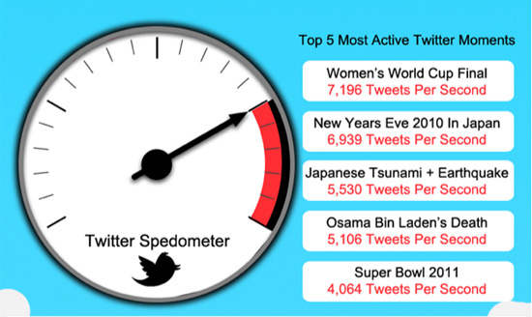
Show don’t tell
http://www.smashingmagazine.com/2011/10/14/the-dos-and-donts-of-infographic-design/

Slide 3
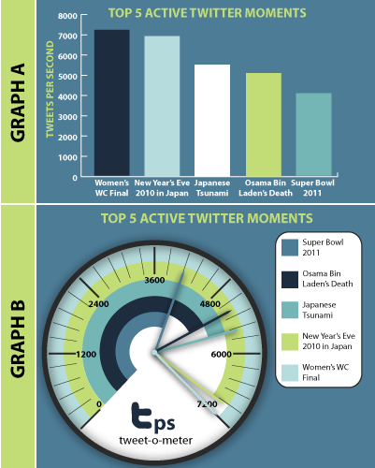
Don’t use an Excel chart.
http://www.smashingmagazine.com/2011/10/14/the-dos-and-donts-of-infographic-design/

Slide 4
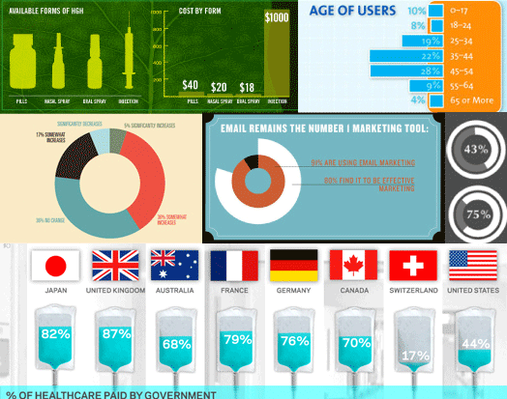
Sample chart execution
http://www.smashingmagazine.com/2011/10/14/the-dos-and-donts-of-infographic-design/

Slide 5
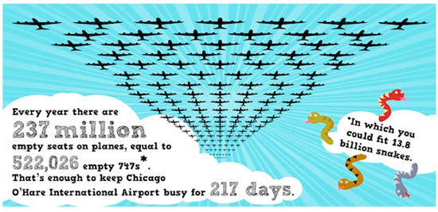
Typography – watch out
http://www.smashingmagazine.com/2011/10/14/the-dos-and-donts-of-infographic-design/

Slide 6
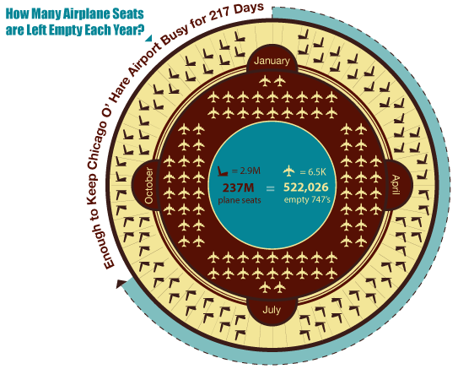
Typography – watch out
http://www.smashingmagazine.com/2011/10/14/the-dos-and-donts-of-infographic-design/

Slide 7
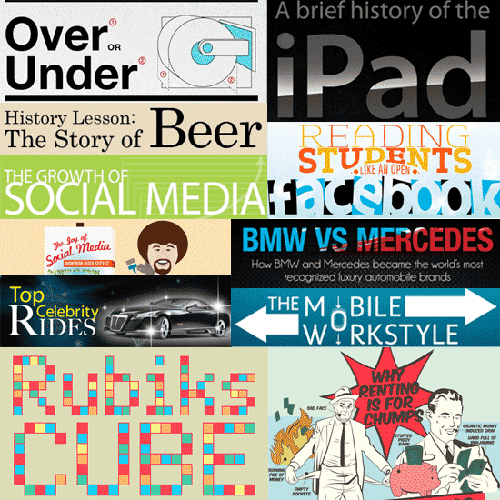
Typography – watch out
http://www.smashingmagazine.com/2011/10/14/the-dos-and-donts-of-infographic-design/

Slide 8
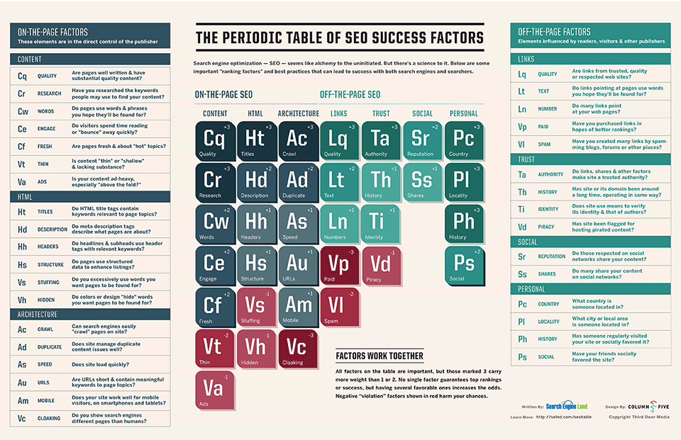
Avoid problems with infographics
Accuracy.
Usability (sizes)
Implementation

Slide 9
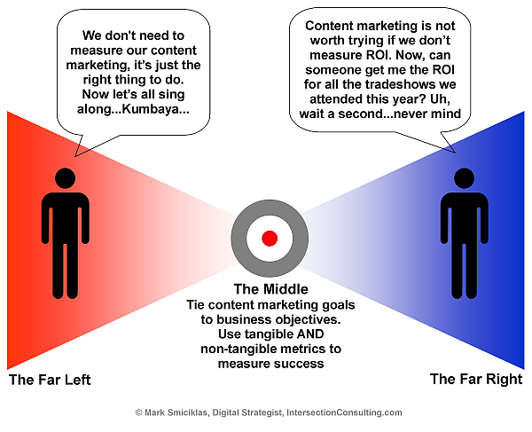
Infographics Metrics
* Links
* Views
* Search
* Ranking
* Following
* Sharing
http://www.socialmediaexplorer.com/social-media-measurement/the-roi-of-infographics/

