Slide 1
Customer Profiling
Janette Toral
DigitalFilipino.com

Slide 2
[name]
[demographic]
[goals]
A Marketer’s
Template
for Creating
Buyer Personas
http://offers.hubspot.com/free-template-creating-buyer-personas

Slide 3
Table of Contents
1
A Brief Introduction to Buyer Personas
2
How to Present Your Buyer Persona
3
An Example of a Complete Buyer Persona
http://offers.hubspot.com/free-template-creating-buyer-personas

Slide 4
1
A Brief Introduction to Buyer Personas
http://offers.hubspot.com/free-template-creating-buyer-personas

Slide 5
What Are Buyer Personas?
?
Buyer personas are fictional representations of your ideal customers. They are based on real data about customer demographics and online behavior, along with educated speculation about their personal histories, motivations, and concerns.
http://offers.hubspot.com/free-template-creating-buyer-personas

Slide 6
How Are Buyer Personas Created?
?
Buyer personas are created through research, surveys, and interviews of your target audience. That includes a mix of customers – both “good” and “bad” -- prospects, and those outside of your contact database who might align with your target audience. You’ll collect data that is both qualitative and quantitative to paint a picture of who your ideal customer is, what they value, and how your solution fits into their daily lives.
http://offers.hubspot.com/free-template-creating-buyer-personas

Slide 7
How Do You Socialize A Buyer Persona?
?
So you’ve done the research and conducted all the interviews … you’ve finally figured out who your buyer persona is. Congratulations! But how do you communicate that new understanding of your target customer with your entire organization? After all, if your sales and marketing teams don’t understand who they’re speaking to, it’s hard to craft a message that really resonates.
http://offers.hubspot.com/free-template-creating-buyer-personas

Slide 8
Use This Template!
That’s why we’ve created this handy-dandy PowerPoint – so you can quickly explain your buyer persona and disseminate that information across the organization in a palatable, organized format. This template will walk you through how to input and format the information you’ve collected about your persona in a way that’s extremely easy for your entire company to understand. And since your research is already done, this is the easy part!
http://offers.hubspot.com/free-template-creating-buyer-personas

Slide 9
Persona Name
BACKGROUND:
Basic details about persona’s role
Key information about the persona’s company
Relevant background info, like education or hobbies
DEMOGRAPHICS:
Gender
Age Range
HH Income (Consider a spouse’s income, if relevant)
Urbanicity (Is your persona urban, suburban, or rural?)
IDENTIFIERS:
Buzz words
Mannerisms
You can find this information by administering online surveys of your target audience.
http://offers.hubspot.com/free-template-creating-buyer-personas

Slide 10
Persona Name
GOALS:
Persona’s primary goal
Persona’s secondary goal
CHALLENGES:
Primary challenge to persona’s success
Secondary challenge to persona’s success
HOW WE HELP:
How you solve your persona’s challenges
How you help your persona achieve goals
Conduct interviews with your target audience to learn about their goals and challenges in more detail.
http://offers.hubspot.com/free-template-creating-buyer-personas

Slide 11
Persona Name
REAL QUOTES:
Include a few real quotes – taken during your interviews – that represent your persona well. This will make it easier for employees to relate to and understand your persona.
COMMON OBJECTIONS:
Identify the most common objections your persona will raise during the sales process.
Identifying common objections will help your sales team be better prepared during their conversations.
http://offers.hubspot.com/free-template-creating-buyer-personas

Slide 12
Persona Name
MARKETING MESSAGING:
Key messages that will resonate with what your target customer wants.
ELEVATOR PITCH:
Your quick description of service or product to customer
Identifying common objections will help your sales team be better prepared during their conversations.
http://offers.hubspot.com/free-template-creating-buyer-personas

Slide 13
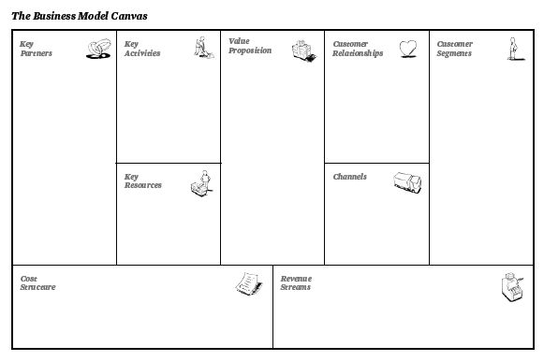
Valle Allegre
Business Model Canvas
Online lead generators (bloggers / freelancers)
BPO / Companies in the area.
Media (feature)
Videographers / Podcaster / Photographer
Site ocular
Online promotion
Customer relationship
Property affordable for people with monthly income of P12,000.
Strong telco signal in areas.
Agent resides in area.
Train / give freelancing opportunity
Self-service
Chat support.
Real Estate Service Professionals who would like to learn digital marketing to boost business.
Workers residing in Calamba Laguna either renting or living with relatives.
Single parent who want to live in a remote area and work from home
Online presence
Transportation
CRM
Social network.
E-mail.
Mobile.
Face-to-Face
Events
Telecommunication cost.
Advertising budget
Online Maintenance
Transportation
Partner budget
Property purchase
Rental
Bigger or 2nd unit or different unit
Referral or other needs

Slide 14
2
How to Present Your Buyer Persona
http://offers.hubspot.com/free-template-creating-buyer-personas

Slide 15
Valle Alegre Club Buyer Persona Overview
Insert your company name, as well as the month and year in the gray text on this slide.
Month, Year
http://offers.hubspot.com/free-template-creating-buyer-personas

Slide 16
Independent Nancy
BACKGROUND:
Single parent with one child
Working at the moment but would like to work from home.
College level. Into various work and sideline.
DEMOGRAPHICS:
Female
21-28
P15,000 per month
Suburban
IDENTIFIERS:
I want to work from home and take care of my child.
Work-home-work-home
You can find this information by administering online surveys of your target audience.
http://offers.hubspot.com/free-template-creating-buyer-personas

Slide 17
Independent Nancy
GOALS:
Be a successful consultant while working from home.
Take care of family and be hands-on 100%.
CHALLENGES:
Current work and time needed leaves little opportunity for growth.
Quality of care given to children becoming a concern.
HOW WE HELP:
Provide training, mentorship, opportunities to work from home.
Offer affordable housing options that their projects can pay for and help meet their personal needs.
Conduct interviews with your target audience to learn about their goals and challenges in more detail.
http://offers.hubspot.com/free-template-creating-buyer-personas

Slide 18
Persona Name
REAL QUOTES:
Gusto ko magkaroon sariling bahay kasama ang anak ko. Maganda rin sana kung sa bahay na lang ako mag-work.
COMMON OBJECTIONS:
Baka hindi ko siya ma-sustain. Baka hindi reliable ang telecoms diyan.
Identifying common objections will help your sales team be better prepared during their conversations.
http://offers.hubspot.com/free-template-creating-buyer-personas

Slide 19
Persona Name
Marketing Messaging:
Own a house for only P3,000 per month. Ideal place for single parents wanting to start all over again.
Own a house for only P3,000 per month. Has H+ phone signal. Great for work from home moms.
Elevator Pitch:
START ALL OVER AGAIN. Work from home at a place you can call your own for only P3,000 per month
Identifying common objections will help your sales team be better prepared during their conversations.
http://offers.hubspot.com/free-template-creating-buyer-personas

Slide 20
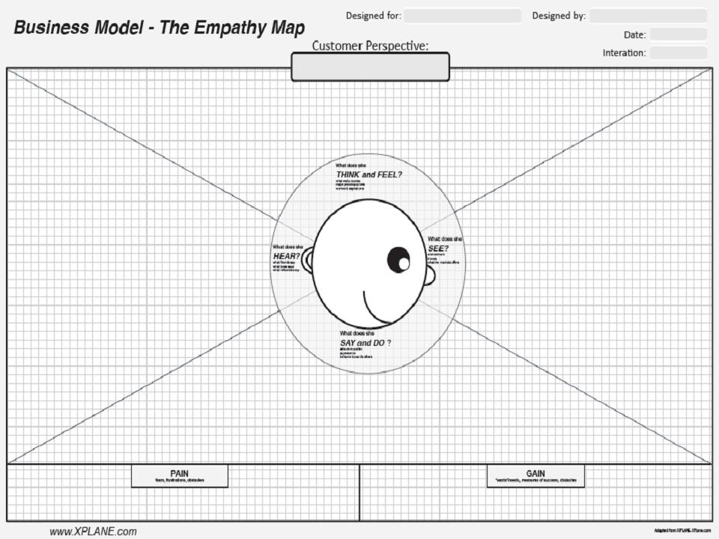
Digital Marketing for Real Estate Industry Program
Janette Toral
#4 understand your audience
INDEPENDENT NANCY
What really counts: Becoming successful and raise child(ren).
Major preoccupation: Income and child’s present and future.
Worries: Problems in child care, career, family, friends.
Aspiration: Successful in business, child care, peaceful life.
Friends say: “Mag-work hard ka para ma-promote ka.”
Environment: Too much expenses and pressures to cope with. Hindi kayang sumabay. No one cares for child well.
Boss say: “Bawal mag absent.”
Friends: No stable job. Magastos. Mautang. Problema.
Influencers say: “Hindi maalagaan ang anak mo.”
Market offers: Working in odd hours. Low pay for starters. One absent – fired agad.
Behavior towards others:
“Overtime. Convert para sa benefits.”
Appearance:
Fashionable. Presentable.
Attitude in public:
Frugal. Time conscious.
Doesn’t discuss problems.
Fears: Lose job. Child gets sick.
Frustration: Making ends meet
Wants / Needs: Income (at home)
Take care of child well.
Measure success:
# of clients. Income
Happy child.
Obstacle:
Time management.
Obstacle: Time
management

