Slide 1
Lesson 1 Task
Fill up the Porter Gale Funnel Test reflecting your passion as a Real Estate Service Professional.
Fill up the Personal Business Model Canvas showing your desired framework of your business practice.
For every customer defined, create a customer empathy map to document your understanding of them.
This will serve as input on your digital marketing messages and communications.

Slide 2
Porter Gale FUNNEL TEST
Passion
Passion
Passion
Sweet Spot
TONE
Purpose

Slide 3
Jan
Janette Toral
E-Commerce Boot Camp
Digital Influencer Boot Camp
Blog Network
Software Process Improvement
Blog & Social Media Entrepreneur Course
DigitalFilipino Club
DigitalFilipino.com
E-Commerce Entrepreneurs needing advise or support.
Bloggers wants to earn income.
Advertisers reach out to bloggers.
Individuals interested in digital marketing.
Companies need help in process imrpovement
”Samurai”
Educational institutions (UP-ITDC, AIE College, STI, and Ateneo Rockwell)
DigitalFilipino Club members
eLearning Edge
Teaching Face2Face / online
Learning
Writing articles
Consultation
Organize events
One-on-one
Online consultation
(online meetings or exclusive forums)
DigitalFilipino.com
Knowledge on e-commerce, digital marketing, blogging
Social Media
Blog
Webinar
Forums
Mobile, Email
Website, Books
Webinars,
Educational videos
Boot camps
Club members, training opportunities, speaking engagements, recognition, awards, friendship with community members, DigitalFilipino Start up 100 Project

Slide 4
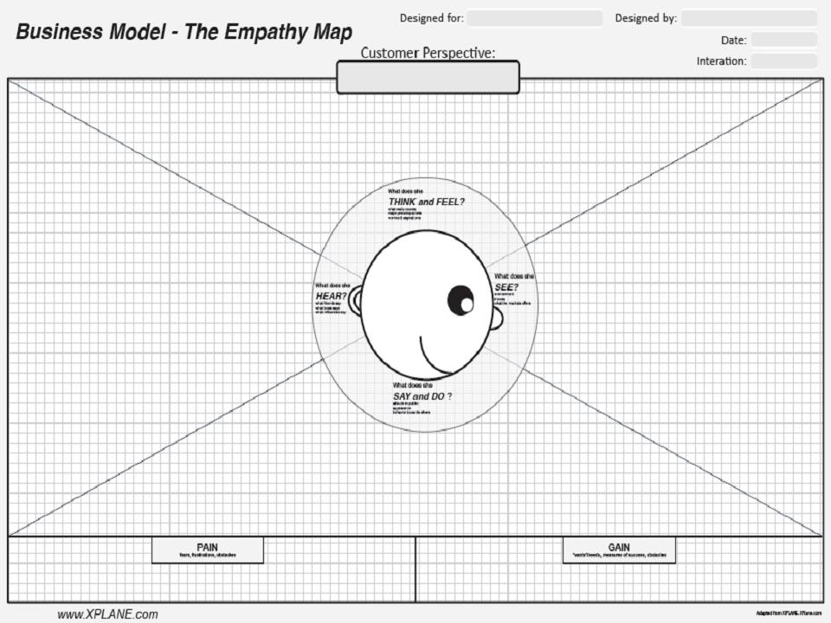

Slide 5
References
Business model generation http://www.slideshare.net/HFincubator/business-model-generation-14863157
Business model YOU http://www.ideogram.us/BMY_preview/Business_Model_You_preview.pdf
Porter Gale Funnel Test http://www.influentialblogger.net/2013/06/what-brings-you-success-head-heart-or.html

